Slide 1


SCENARIO PLANNING

Slide 2

Module Agenda
Introduction to scenario planning
Scenario Planning Key Steps
Advantages of Scenario Planning
Partial Dependency Plot (PDP)
Practical Project 1: GenAI for Scenario Planning using Simple Datasets
Practical Project 2: Store Scenario Planning Use Case
Practice Opportunity
© All rights reserved for Dr. Ryan Ahmed @Stemplicity Inc.

Slide 3
Financial Planning and Analysis
Data Wrangling & Analysis: Automate reconciliation and analysis of financial data.
Competitor Analysis: Analyze competitors' financials and strategic positioning.
Anomaly Detection: Identify errors in financial transactions with AI.
Time Series Forecasting: Predict financial performance using historical data and market trends.
Variance Analysis: Analyze actuals vs. budgets to pinpoint variances and corrective actions.
Scenario Planning: Model scenarios to evaluate business decisions' financial impacts.
Financial Narratives: Generate AI-driven insights for clear stakeholder communication.
Cost Optimization: Identify inefficiencies and recommend cost-saving measures.
Data Visualization: Visualize financial data for strategic decision making
Financial Prediction Using ML Regression: Predict financial metrics such as revenues& expenses.
Financial Planning and Analysis (FP&A) is a critical business function that focuses on providing financial insights to support decision-making and drive a company’s strategic objectives.
It involves analyzing financial data, forecasting future financial performance, budgeting, and offering recommendations to enhance financial health and operational efficiency.
© All rights reserved for Dr. Ryan Ahmed @Stemplicity Inc.

Slide 4
INTRODUCTION TO SCENARIO PLANNING

Slide 5
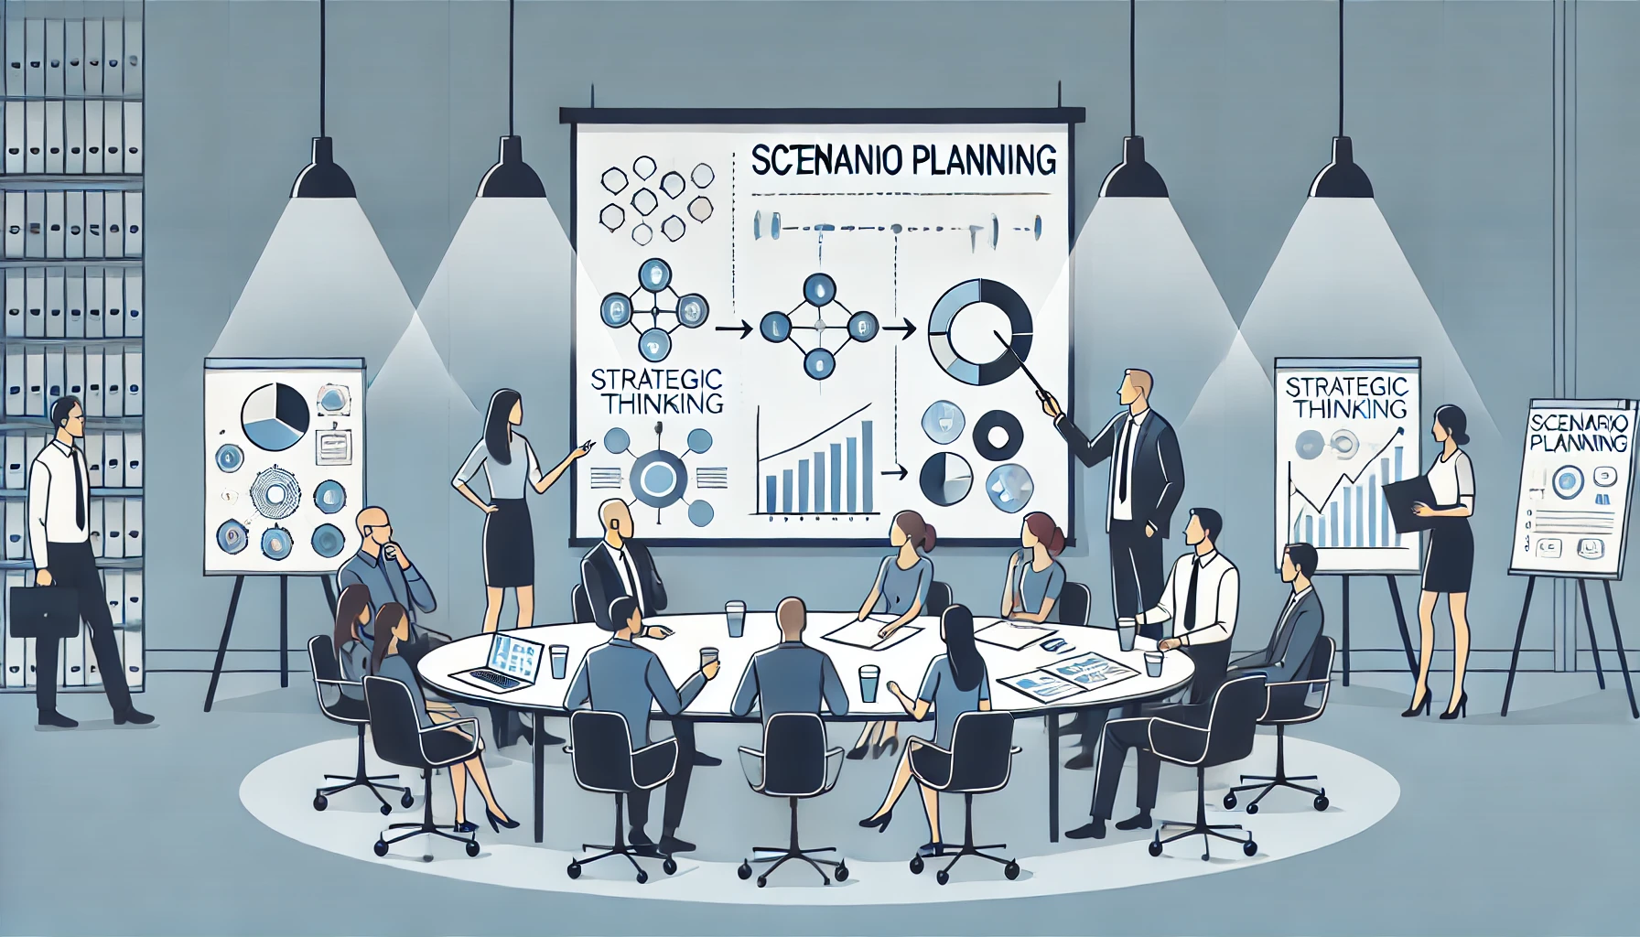
Introduction to Scenario planning
Scenario planning is a strategic planning method for creating and analyzing multiple, plausible future scenarios to aid in decision-making and preparedness.
It helps organizations anticipate potential risks, opportunities, and uncertainties by considering various factors that could influence future outcomes.
SCENARIO PLANNING
© All rights reserved for Dr. Ryan Ahmed @Stemplicity Inc.

Slide 6
Understand Baseline Trends
Analyze historical trends in sales, promotion spend, and the Housing Market Index.
Use time series graphs & correlation analysis to identify patterns.
Build a Predictive Model
Create a sales forecast using regression models with Promotion Spend and Housing Market Index as predictors.
Create Scenarios
Simulate future conditions by adjusting inputs:
Best: +20% promotion spend, +10% Housing Index.
Worst: -30% promo, -15% Housing Index.
Moderate: Maintain current averages.
Run Simulations
Use the predictive model to estimate sales under each scenario.
Visualize Results
Present forecasts using bar charts or dashboards to compare scenarios.
Derive Insights
Assess the impact of changes in inputs.
Make Recommendation
Suggest adjustments to promotion strategies.
Highlight the influence of external factors and propose adaptive strategies.
Scenario Planning Steps
© All rights reserved for Dr. Ryan Ahmed @Stemplicity Inc.

Slide 7
Benefits of Scenario Planning
Improves Decision-Making: Prepares for multiple futures, enabling informed and strategic choices.
Enhances Adaptability: Builds resilience by identifying risks and opportunities for rapid adjustments.
Promotes Long-Term Thinking: Aligns actions with future goals, overcoming short-term biases.
Encourages Innovation: Inspires creative solutions by exploring diverse possibilities.
Boosts Collaboration: Engages stakeholders, and shared strategies.
© All rights reserved for Dr. Ryan Ahmed @Stemplicity Inc.

Slide 8
WHAT IS PARTIAL DEPENDENCE PLOT (PDP)?

Slide 9
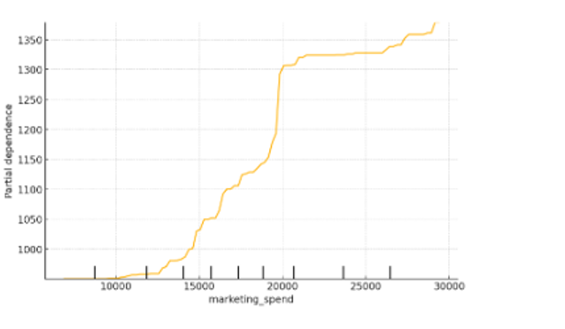
Partial Dependence Plot (PDP)
A Partial Dependence Plot (PDP) is a tool used to visualize the relationship between a feature (or multiple features) and the predicted outcome of a model.
It helps to understand how the model's predictions depend on a specific feature, marginalizing other features.
Due to the limits of human perception, the size of the set of input features of interest must be small (usually one or two); thus, the input features of interest are usually chosen among the most important features.
© All rights reserved for Dr. Ryan Ahmed @Stemplicity Inc.

Slide 10
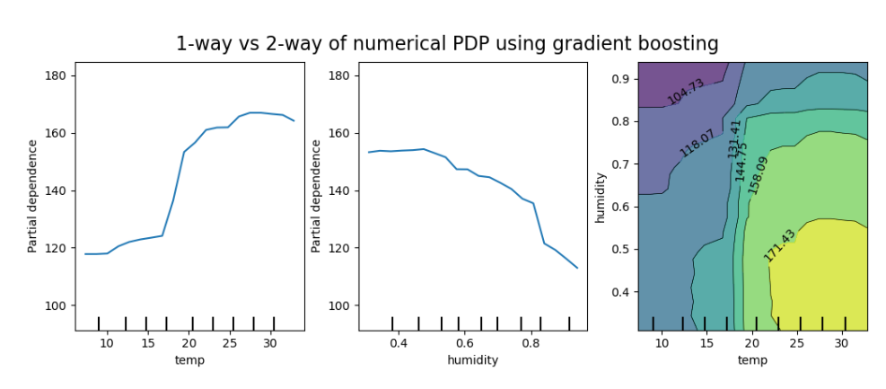
Partial Dependence Plot (PDP): Example
1-way PDPs shows the interaction between the target response and an input feature of interest.
The left plot shows the effect of the temperature on the number of bike rentals; higher temperature is related to a higher number of bike rentals.
2-variable PDP shows the dependence of bike rentals on joint temperature and humidity.
© All rights reserved for Dr. Ryan Ahmed @Stemplicity Inc.
Source: https://scikit-learn.org/stable/modules/partial_dependence.html

Slide 11
PRACTIAL PROJECT 1: GENAI FOR SCENARIO PLANNING

Slide 12
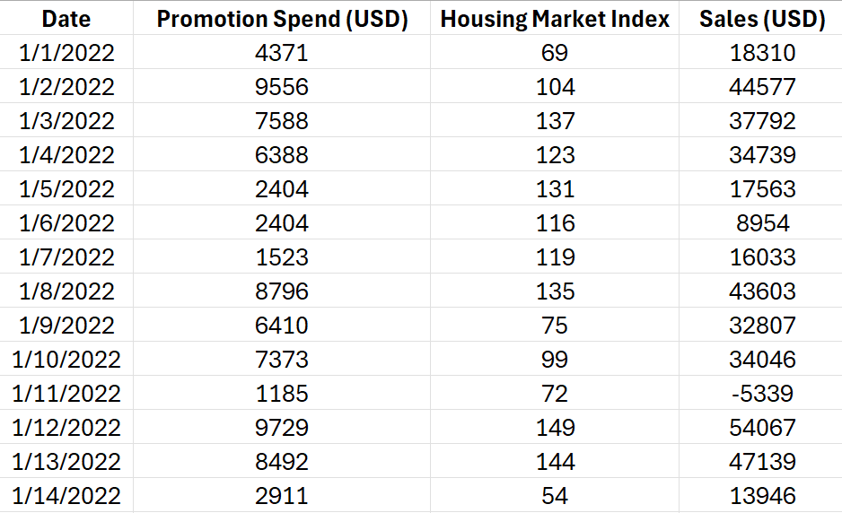
Problem Statement
This dataset provides monthly sales figures, promotion spending, and housing market trends, which are critical for understanding how internal and external factors influence business performance.
The goal is to use this data for scenario planning to evaluate the potential impact of varying promotion budgets and changes in macroeconomic conditions on future sales.
We will simulate best-case, worst-case, and moderate scenarios to guide strategic decision-making to optimize promotional efforts and mitigate risks from external market fluctuations.
Note: The Housing Market Index (HMI) is an economic indicator that measures the sentiment and outlook of homebuilders in the housing market.
© All rights reserved for Dr. Ryan Ahmed @Stemplicity Inc.

Slide 13
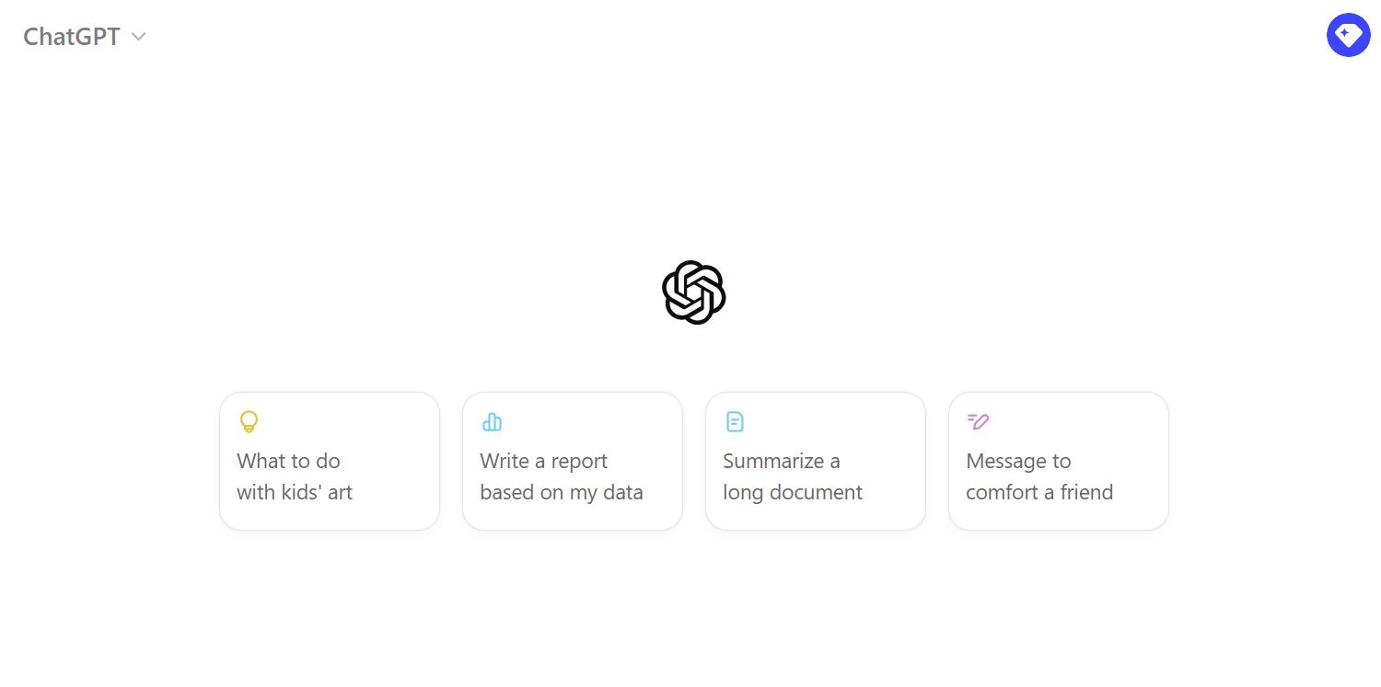
Practical Project
🔗 Click here to explore ChatGPT ChatGPT Signup
💡 Click here for AI Prompts Explore Prompts
© All rights reserved for Dr. Ryan Ahmed @Stemplicity Inc.

Slide 14
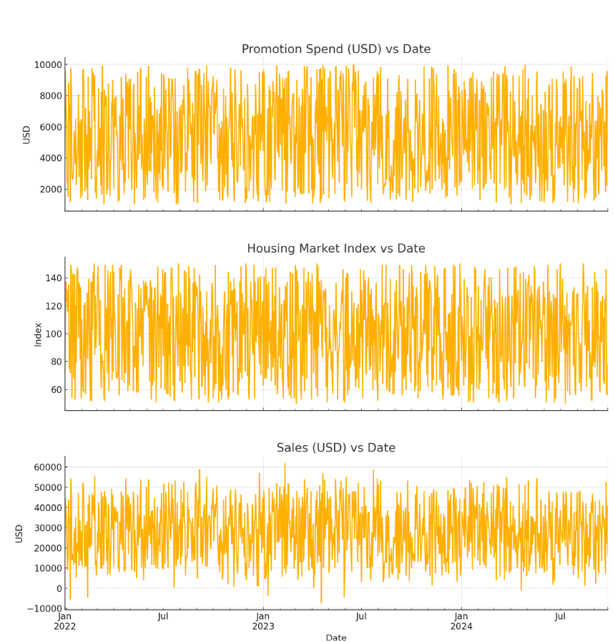
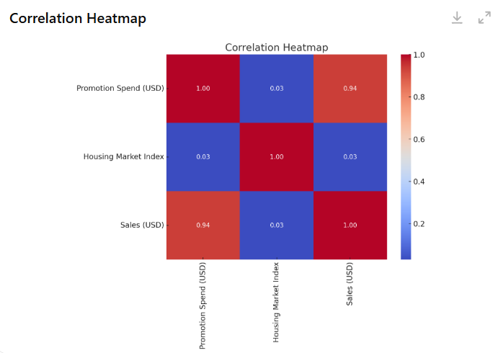
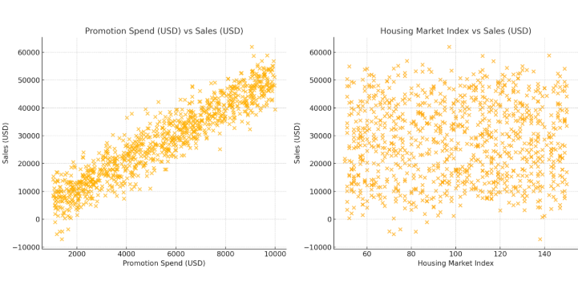
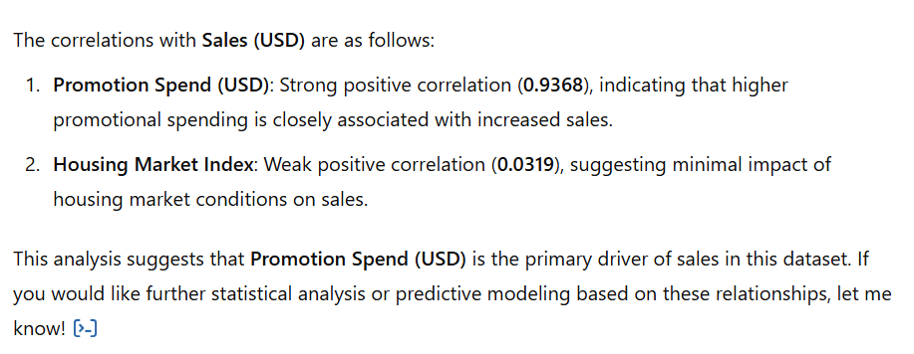
EDA Results
© All rights reserved for Dr. Ryan Ahmed @Stemplicity Inc.

Slide 15
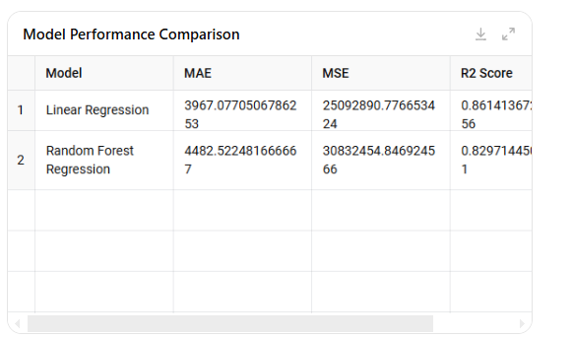
Predictive Model
© All rights reserved for Dr. Ryan Ahmed @Stemplicity Inc.

Slide 16
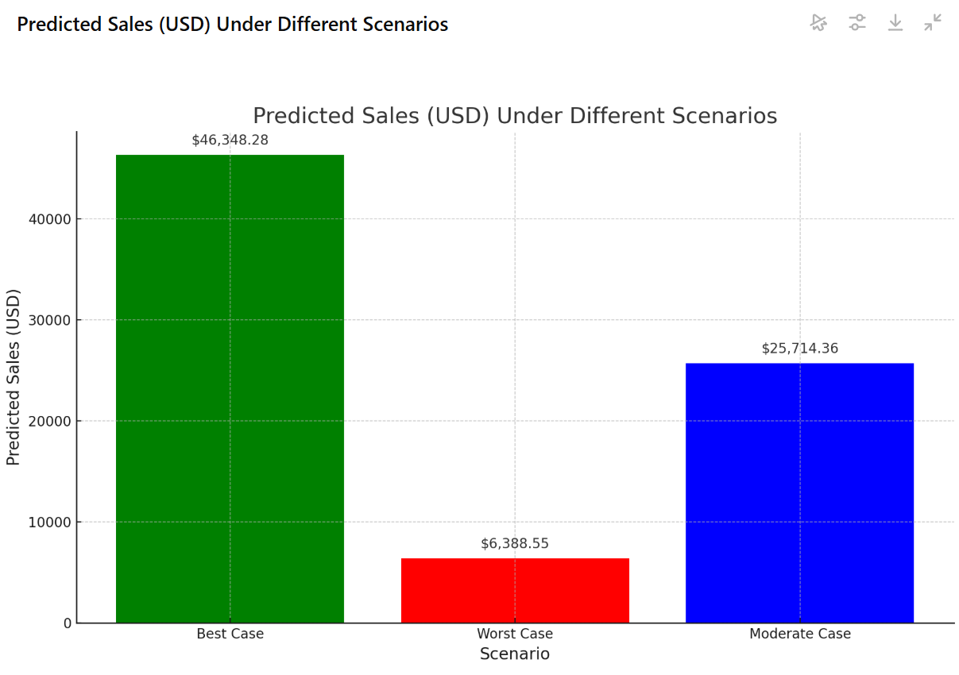
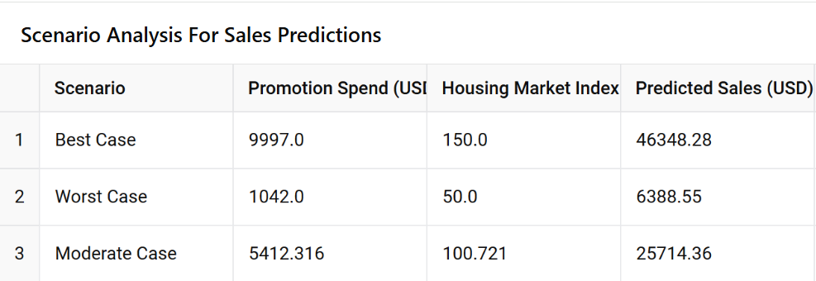
Scenarios
© All rights reserved for Dr. Ryan Ahmed @Stemplicity Inc.

Slide 17
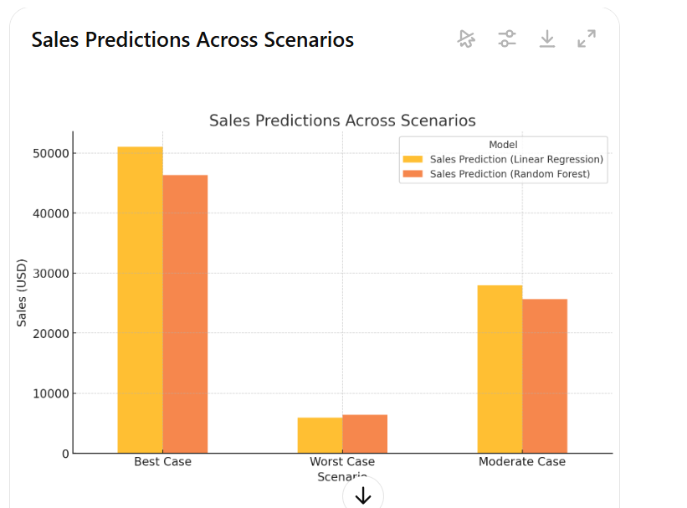
Scenarios – Run 2
© All rights reserved for Dr. Ryan Ahmed @Stemplicity Inc.

Slide 18
PRACTICE OPPORTUNITY

Slide 19

Practice Opportunity
You are provided with data on Sales (USD), Unemployment Rate, and Interest Rate data for Walmart. Complete the following tasks:
Exploratory Data Analysis (EDA):
Analyze trends, relationships, and outliers in the data.
Build a Predictive Model:
Forecast Sales (USD) using the provided features.
Validate the model for accuracy.
Scenario Forecasting:
Generate Best Case, Worst Case, and Moderate Case forecasts.
Justify assumptions for each scenario based on economic conditions.
Actionable Insights:
Deliver clear recommendations based on the forecasted scenarios.
© All rights reserved for Dr. Ryan Ahmed @Stemplicity Inc.

Slide 20
Practice Opportunity Solutions
🔗 Click here to explore ChatGPT ChatGPT Signup
💡 Click here for AI Prompts Explore Prompts
💡 Click here for Practice Opportunities Solution Explore Prompts
© All rights reserved for Dr. Ryan Ahmed @Stemplicity Inc.

Slide 21
PRACTICAL PROJECT 2: GENAI FOR SCENARIO PLANNING FOR A DEPARTMENT STORE

Slide 22
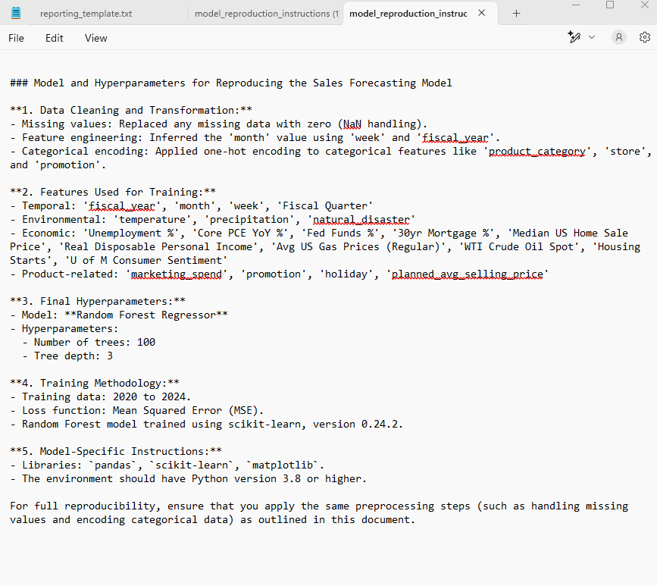
Problem Statement
We will apply scenario planning using Walmart datasets. The model will take the miami_training.csv and model_reporoduction_instructions.txt to train a machine learning regression model to predict sales.
© All rights reserved for Dr. Ryan Ahmed @Stemplicity Inc.

Slide 23
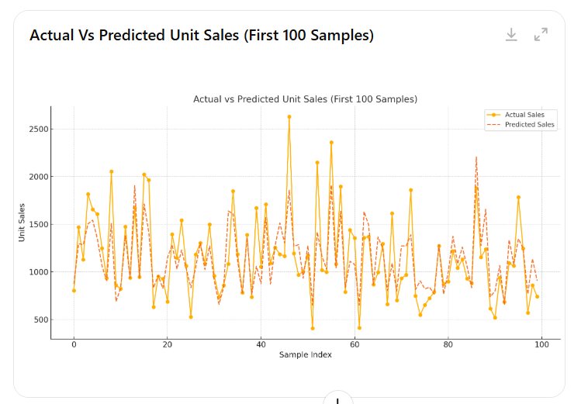
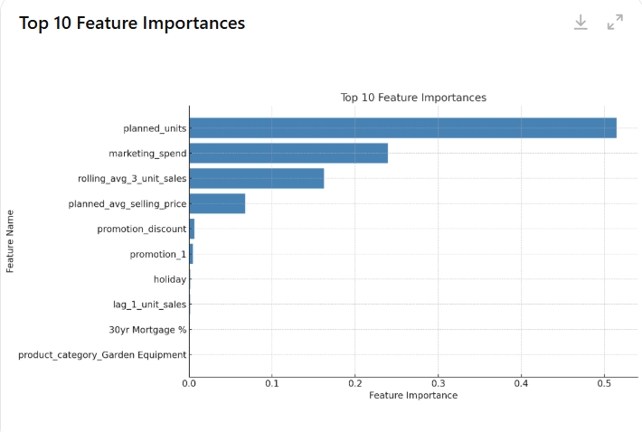
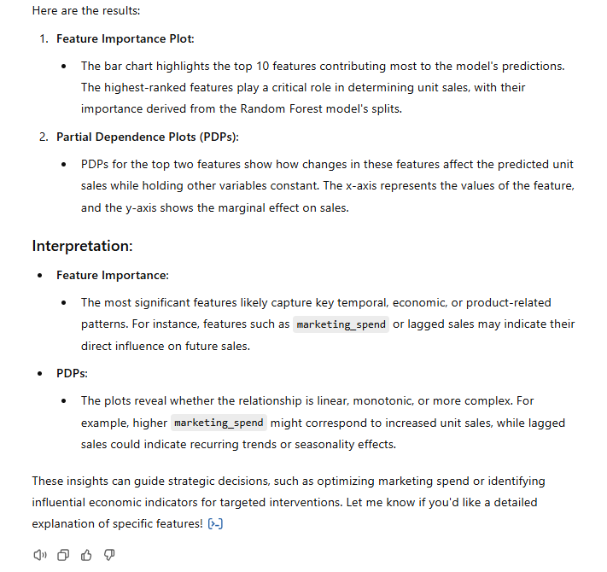
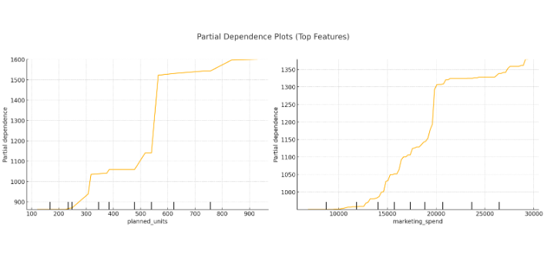
Live Demo
© All rights reserved for Dr. Ryan Ahmed @Stemplicity Inc.

Slide 24
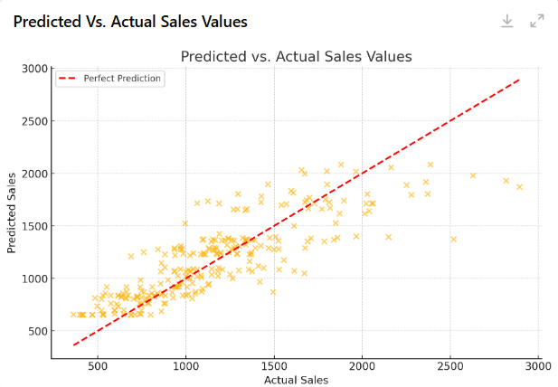
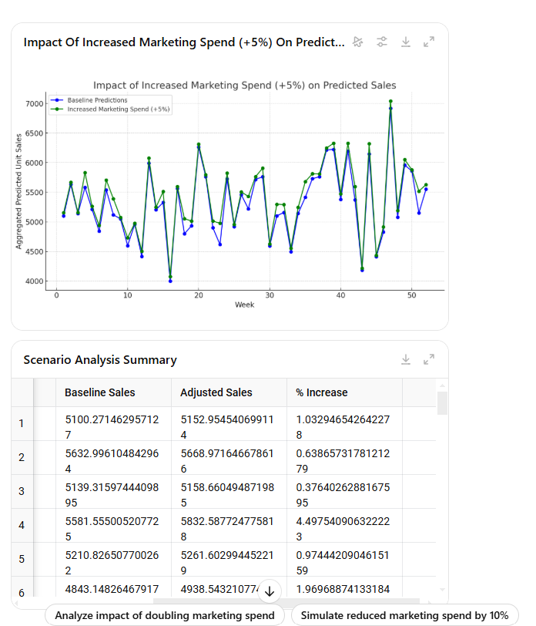
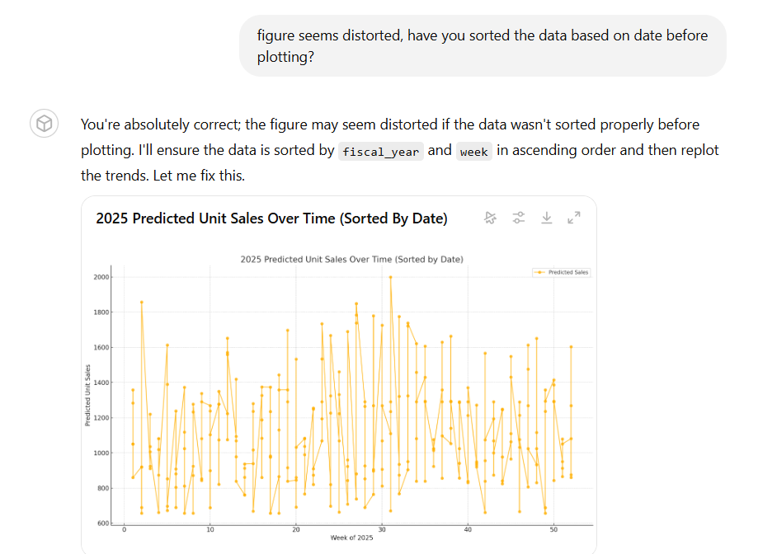
Live Demo
© All rights reserved for Dr. Ryan Ahmed @Stemplicity Inc.

Slide 25
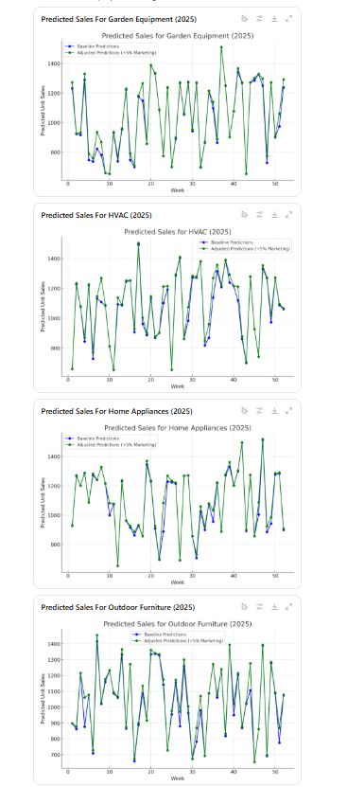
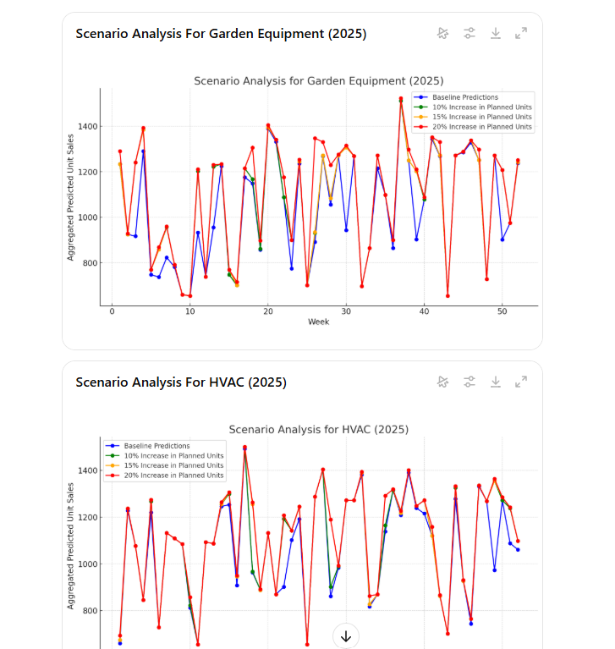
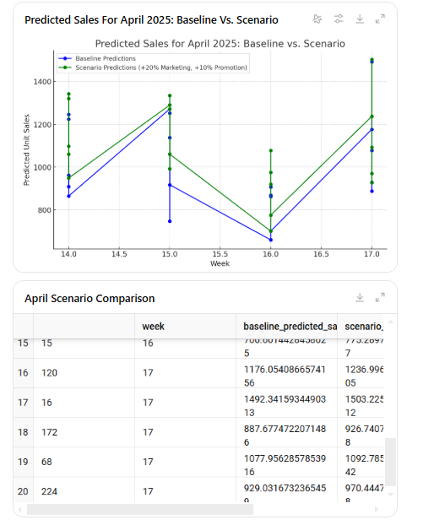
Live Demo
© All rights reserved for Dr. Ryan Ahmed @Stemplicity Inc.

Slide 26
Thank you!

